Slide 1
Oracle SOA Training
Why this course
What is SOA
Course Contents

Slide 2
Agenda
Why should you learn this
What is SOA
What is its market value
Oracle SOA Suite
Course contents
What extra does this course offer
About the instructor

Slide 3
Why should you learn this?
Because it is
  In 60s
  In 70s
  In 80s
  In 90s
  In 2000
  Now
the next big thing
  it was low level programming
  it was BASIC and C
  it was medium size applications, database
  it was Java
  onwards, its enterprise apps
  middleware
Notes:
Middleware is hot because with the increase in the number of fields computers are being used, the need for them to collaborate has increased multi-fold.
Middleware provides the glue, the medium for different applications to ‘talk’ to each other. Middleware can be a single application, or it can be an entire server.
Over the last 20 years, organizations invested heavily in automating specific business tasks and processes.
This proved to be a good investment increasing productivity across the board and improving productivity exponentially. However, it did bring up some issues. How do you not just make your business process automated, but optimized? How can I ensure that the data used by all systems is the same and of high quality? How can I instrument my business processes to include relevant contextual information for key decision makers? All at the same time improving the ability for my organization to react and keeping costs low? While there is no one answer for all these questions, one technology helps to address all the points outlined above – Integration. Integration is common requirement across all of these problems.

Slide 4
What is Middleware
A software that helps disparate and distributed applications to collaborate with each other
Helps leverage the best-of-breed products
Companies can get more ROI by being able to reuse
SOA is the hottest middleware strategy till date. Examples:
  ESB, BPEL
Notes:
Middleware is computer software that connects software components or applications. It is used most often to support complex, distributed applications. It includes web servers, application servers, content management systems, and similar tools that support application development and delivery. Middleware is especially integral to modern information technology based on XML, SOAP, Web services, and service-oriented architecture.
Common middleware categories include:
ESB
Short for Enterprise Service Bus, also referred to as a message broker. ESB is an open standards-based distributed synchronous or asynchronous messaging middleware that provides secure interoperability between enterprise applications via XML, Web services interfaces and standardized rules-based routing of documents. In practice, this means that data files are passed to and from their destinations based on pre-established guidelines that are common to all parties sharing the information to ensure that the data maintains its integrity as it is routed. The multi-language and multi-platform design of an ESB allows enterprises to process data between applications from various sources. Two common distributed computing architectures used by ESBs are J2EE and .NET. ESB is an extension of EAI, an earlier form of middleware, but ESB adds several key functions:
transformation – the ability to transform XML documents from one data format into another so that the receiving party can interface with the data in an application format that is different from the one in which it is sent.
portability – the ability to share the data between different computer systems and operating environments.
load balancing/clustering – the ability to distribute processing among several devices so that no one device becomes overloaded
failover – the ability to transfer messaging functions to another server if one should fail during the data exchange.
Oracle ESB, Oracle Service Bus, Sonic ESB, Cape Clear Server and PolarLake Jintegrator are examples of commercial ESB products.
BPEL
Short for Business Process Execution Language, it is an XML-based language designed to enable task-sharing for a distributed computing or grid computing environment - even across multiple organizations - using a combination of Web services. BPEL has been created by a number of people working for a number of companies, among them Adobe, Avaya, BEA, Hewlett-Packard, IBM, Microsoft, NEC, Novell, Oracle, and SAP – so essentially it has wide support
TP monitors
Short for transaction processing monitor, a program that monitors a transaction as it passes from one stage in a process to another. The TP monitor's purpose is to ensure that the transaction processes completely or, if an error occurs, to take appropriate actions.
DCE environments
Short for Distributed Computing Environment, a suite of technology services developed by The Open Group for creating distributed applications that run on different platforms. DCE services include:
# Remote Procedure Calls (RPC)
# Security Service
# Directory Service
# Time Service
# Threads Service
# Distributed File Service
DCE is a popular choice for very large systems that require robust security and fault tolerance.
Example - RS-232C
RPC systems
Short for remote procedure call, a type of protocol that allows a program on one computer to execute a program on a server computer
Object Request Brokers (ORBs)
Short for Object Request Broker, a component in the CORBA programming model that acts as the middleware between clients and servers. In the CORBA model, a client can request a service without knowing anything about what servers are attached to the network.
Database access systems
Message Passing

Slide 5
What is SOA?
“Next big thing ??”, you would wonder, “Can you tell me more? What is SOA all about?”

Slide 6
What is Service-Orientated Architecture?
Not a technology or product, more a design approach
Exposure of product functionality as “services”
  Services are atomic, do not depend on other services run beforehand
  Technology and implementation neutral - J2EE, .NET, PL/SQL
  Services published in directories
Services can exchange data using a common platform (ESB) or can be orchestrated using declarative language (BPEL)
Applications are “loosely coupled”
Promotes re-use of code, assembling of applications from existing processes
Architecture for Oracle Fusion Applications

Slide 7
What is Service-Orientated Architecture?
Oracle
Financials
Custom Order
Application
New Web
Application
Standard Interface
Standard Interface
Standard Interface
Service Oriented Technology (ESB, BPEL)
Standard Interface
Standard Interface
Standard Interface
Siebel
CRM
Mainframe HR
Application
.NET Inventory
Application

Slide 8
What’s the Big Deal?
“Okay. SOA proposes an application design consisting of weaving together of multiple services”, you would say, “But what’s so great about this S-O-A?”

Slide 9
Why SOA Makes Sense:
Technical Benefits
Building business processes is faster and cheaper:
  Existing services can more easily be reused
  Apps can expose their services in a standard way
Applications can be exposed more easily to diverse clients:
  Windows clients, ASP.NET/JSP, PL/SQL, Java etc.
Applications can adapt to change

Slide 10
Why SOA Makes Sense:
Business Benefits
Business people understand services
  So IT people can talk with them more easily
Business processes become explicit
  So they can more easily be understood and improved (aka customized)
Applications or business processes might be more easily outsourced
  Because they’re well-defined and discrete

Slide 11
Proof ?
“Well, this definitely sounds good … but can you show where SOA has been applied in real world ?”

Slide 12
SOA Application Examples in the real world
Data/Apps Integration
  File to DB (Inbound Interface)
  Information syncing from Oracle EBS to Siebel, PeopleSoft to JDEdwards
Process Portal
  Parallel data processing
  Content publishing
Workflow
  Document Approval
  Leave Application
Modern Web Applications
  Internet Banking
  Contract Management
  New Employee Hire
Business Process Management
  P2P, O2C
  Medicare Eligibility Determination and Enrollment

Slide 13
SOA Application Examples in the real world – Inbound Interface Design
I want to transfer data from legacy system that produces csv output to a database.
Third Party System/
Legacy System
Database
Use a file adapter to easily read a file. You can also specify the frequency to poll for the file, file name pattern, archive the file after reading and so on.
We can validate the data before inserting – verify all the fields conform to a xml schema
We can enrich the data before inserting.
We can perform routing to different locations - write rules to decide whether to insert the data or not, or to insert in some other DB or create another file
Third Party System/
Legacy System
Database
File Adapter
Database Adapter
Validate/
Filter
Enrich
Route
SOA Project developed using ESB

Slide 14
SOA Application Examples in the real world – Information syncing
I capture item information in an Item Management System. However, once the item is entered, this information needs to go to Oracle EBS. Another division wants this information delivered to them in their FTP site
Item Management
System
Oracle EBS
FTP
Item Management
System’s Database
Oracle EBS
Interface Tables
FTP
Use ESB to listen to Item Management System’s Item table. Whenever a record is entered, the ESB is started and this data is sent to the specified location. If tomorrow, I want to send it to one more system, I can do it with minimal effort
Database
Adapter
Apps
Adapter
FTP
Adapter
Validate/
Filter
Enrich
Route
SOA Project developed using ESB

Slide 15




SOA Application Examples in the real world - Parallel Data Retrieval
I want to invite bids for RFQ sent to suppliers. Can I send the RFQ to multiple suppliers in parallel, and then wait for each of the responses
Use parallel processing capabilities of BPEL. BPEL provides a construct called FlowN using which you can spawn as many parallel flows as required, on the fly!

Slide 16
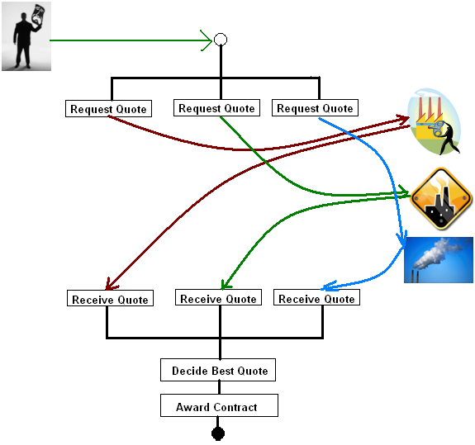
Parallel flow
SOA Project developed using BPEL

Slide 17
SOA Application Examples in the real world – Document Approval
Once a PO is created, it needs to be approved
    Approval depends upon PO Amount. If amount is greater than USD10,000, it needs 3 levels of approval else only 2 levels
    The approvers must be managers of the person submitting.
    If the approval is not obtained in 2 days, the issue should be escalated to next manager
    Any document that contains a line item belonging to IT category must be sent as an FYI to the IT department
    It should be possible to utilize different voting schemes – first approver wins, majority or consensus
Use BPEL to orchestrate human task, business rules to achieve this. For a fine-grained control, use Human task with AMX, that is coming in Oracle SOA 11g

Slide 18
SOA Application Examples in the real world - New Employee Hire
For a new joinee, we need to
    Raise request in access provisioning system for email, VPN etc
    Send filled PDF form for AMEX card
    Update HR tables
    Send email to Sodexho team
Use BPEL to bind these different system and come up with an application. Identify things that can be done in parallel.

Slide 19








SOA Application Examples in the real world – Order to Cash
I want to develop O2C cycle. We have following requirements to be met
  Orders come from a web portal
  Order data is stored in Oracle EBS
  Customer credit rating information comes from bank
  Customer Data accessible using an EJB
  PO Approval can be manual or automated.
  RFQ needs to be sent to various shipping companies and lowest quote should be selected
  Customer must be sent an email and SMS upon Order fulfillment
Use BPEL to bind these different system and come up with an end-to-end system.

Slide 20
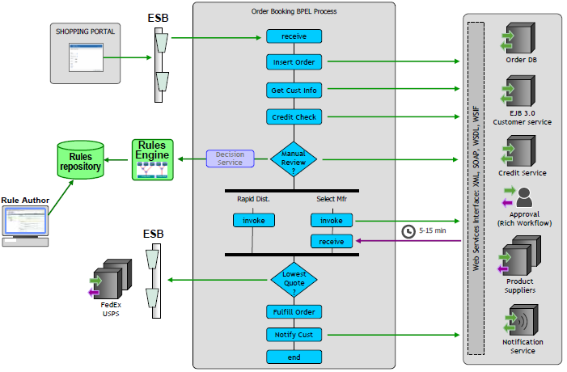

Order data can be sent from Web portal to the BPEL process or in bulk
Talk to Oracle EBS using interface tables, CP, XML Gateway or B2B
Consume web service provided by bank to find out credit rating of customer
Talk to EJB using web service interface
  For automated approval, use Oracle Business Rules
For manual approval, use human tasks (similar to Oracle Workflow).
Send SMS and Email using inbuilt features in BPEL
After receiving all responses, you can use BPEL Switch activity to decide the best quote
Send multiple RFQs simultaneously using BPEL

Slide 21
Market Value
Market value is directly proportional to the number of potential applications
Market value is inversely proportional to number of professionals
    In current times, its only your knowledge of new things that can sail you through
Paucity of quality training
    Which is good! Because it means less competition
Integration solutions
    Vendor specific – TIBCO, JCAPS
    Open standard – Oracle SOA
With Oracle emerging as the leader in Apps, Oracle SOA has a secure future
Notes:
SOA is not a technology or product, more a design approach

Slide 22
“hmm…sounds interesting..
So, what do I need to know technically?”

Slide 23
Pre-requisites
Technology wise
  Basic understanding of XML, XSL, XSD
  Core Java knowledge a plus
Excellent career option for
  People familiar with Oracle Apps, Peoplesoft, Siebel
  Java, .NET developers
  Web developers
  Sun JCaps, TIBCO, EAI
Notes:
At the end, however, you need to have an ability to
Appreciate that there is value to be unlocked by connecting different systems
understand and appreciate what it takes to make multiple applications work together to deliver something useful.

Slide 24
Recap
Why should you learn this
What is Middleware
What is Service-Orientated Architecture?
Why SOA Makes Sense: Technical Benefits
Why SOA Makes Sense: Business Benefits
SOA Application Examples in the real world
  File to DB
  Information syncing
  Content Publishing
  Parallel Data Retrieval
  Document Approval
  New Employee Hire
  Procure to Pay
Market Value
Pre-requisites

Slide 25
What are we learning in this course Oracle SOA
In this course we are learning two of the most important offerings in Oracle SOA Suite
  BPEL and ESB
Other things in Oracle SOA Suite
  BAM – real time monitoring, KPI etc
  OWSM – provide security to web services
  ODI – useful for bulk data loading, transformations
  OBR – author business rules separately
  SR – Service registry to keep track of all services

Slide 26

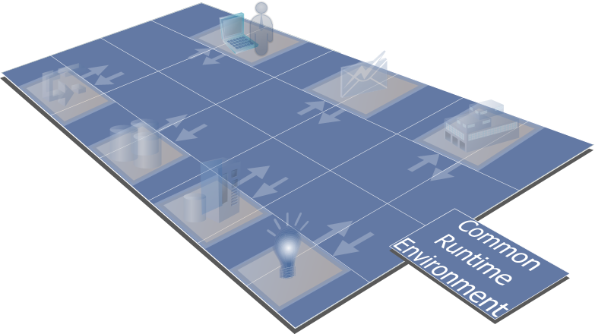
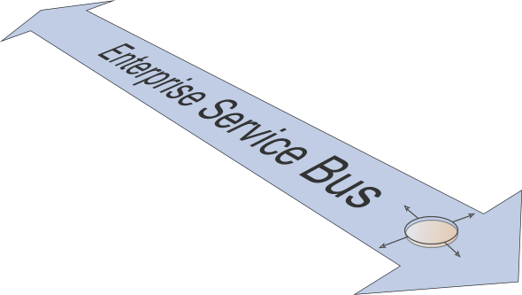


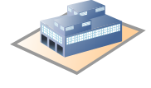

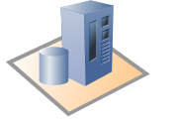

Enterprise Service Bus
Portal Service
SOAP
Service Request
(e.g. .NET)
B2B
Interactions
Service
Flow
Data
Existing
Applications
New
Service Logic

Slide 27

ESB Analogy

Slide 28
ESB
To integrate old and new, service-oriented architecture (SOA) needs an infrastructure that can connect any IT resource, whatever its technology or wherever it is deployed.
To be flexible, it needs an infrastructure that can easily combine and re-assemble services to meet changing requirements without disruption.
And to be dependable, it needs an infrastructure that is robust and secure.
This infrastructure is the enterprise service bus (ESB).

Slide 29
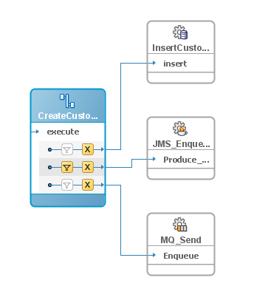
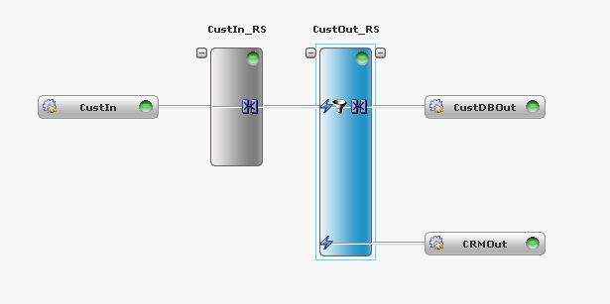
ESB Example – Data synchronization
2
Customer details are
logged in the audit
database
2
Customer details
are enqueued on
JMS to the CRM
CreateCustomer.wsdl
event
1
An event is placed on
the bus to notifying a new customer.
Payload is customer details.
2
Customer details
are enqueued on
MQ to the mainframe

Slide 30
ESB Example - Inbound Interface Design
Legacy Systems
ESB
Oracle ERP
FTP/File
FTP Adapter
Data
Transformation
Conc Program
DB Adapter
Business Logic
Open Intf Table
File Adapter
EBS Adapter
Oracle API
Some Database
Data Mapping
DB Adapter
PL/Sql Cust Pkg’s
AQ Adapter
Work Flow Brgd
Queue/
Topic
Work Flow
JMS Adapter
Web Service
XML Gate Way
Data Import
Legacy System
MQ Adapter
Derivations
AQ Adapter
Main Frame
Oracle DB

Slide 31
ESB Example - Outbound Interface Design
Oracle ERP
ESB
External Systems
Data
Transformation
FTP Adapter
FTP
Business Logic
File Adapter
FileSystem
DB Adapter
Data Extraction
Data Mapping
Database
Oracle Base
Tables
DB Adapter
Main Frame
CICS
JMS Adapter
Queue/
Topic
Data Export
MQ Adapter
MQ
Oracle DB
Derivations
AQ Adapter
AQ

Slide 32
Some of the Adapters Available for Oracle SOA Suite…
Applications
Oracle Applications
SAP R/3, mySAP
Peoplesoft
JD Edwards
Siebel
Clarify
Lotus Notes
Ariba
AXIOM mx/open
Baan
BroadVision
Clarify
Commerce One
Hogan Financials
i2 Technologies
Lawson
Livelink
Manugistics
Microsoft CRM
Vantive
Walker Interactive
Remedy
Salesforce.com
Databases
Oracle 8i and above
IBM DB/2
Informix
Clarion
Clipper
Cloudscape
DBASE
Dialog
Essbase
FOCUS Data Access
Great Plains
Microsoft SQL Server
MUMPS (Digital Standard MUMPS)
Navision Financials (ODBC 3.x)
Nucleus
Paradox
Pointbase
PROGRESS
Red Brick
RMS
SAS Transport Format
Sybase
Teradata
Unisys DMS 1100/2200
UniVerse
Technology
SOAP
HTTP, HTTP-S
Email – POP3, SMTP, IMAP
FTP, FTP-S
Flat Files
LDAP
JMS
Oracle AQ
IBM MQSeries
TIBCO Rendezvous
Socket
Legacy
CICS
IMS/DB
IMS/TM
VSAM
ADABAS
Natural
Tuxedo
CA-Datacom
Screen Scraping
CA-IDMS
C-ISAM,D-ISAM,K-SAM, QSAM
Notes:
Coding:
Bold == Bundled
Green == Sold as an option, direct from Oracle
Normal text == Available through certified partners

Slide 33
Business Process Execution Language BPEL
BPEL:
  Is a technology to create a program that can invoke web services
  It presents a very intuitive flow-chart type representation that can be easily understood and modified
    More technically, it is a markup language for composing a set of discrete services into an end-to-end process flow
  BPEL Process is a web service, hence has a WSDL document that describes its operation
  invokes operations described in interfaces in the WSDL of other services.

Slide 34
BPEL Example – Internet Banking
Account Manager
Card Manager
Services that can be automated
Intra-bank transfer
Application Server
Bank customer calls up at call center
Services that require human interaction
Requests
ADF
Complaints
Bank customer logs on to website
Services provided by other vendors
Billing services
InterBankTransfer
Web
Payment Gateway
Notes:
The slide shows what a BPEL process can do – ‘ORCHESTRATION’

Slide 35
Installation
Softwares
  Oracle SOA Suite 10.1.3.1 patch 10.1.3.5
  Oracle JDeveloper 10.1.3.5
  Oracle DB 10g or Oracle 10g XE or SQL Server 2005
System Requirements
  P-IV or equivalent processor
  40GB HDD
  2GB RAM
Notes:
All software downloads are free, and each comes with a Development License that allows you to use full versions of the products at no charge while developing and prototyping your applications (or for strictly self-educational purposes).

Slide 36
D E M O N S T R A T I O N
Oracle Fusion Middleware Integration

Slide 37
Course Objectives
After completing the course, you should be able to do the following:
  Build a BPEL process
  Utilize parallel processing and conditional branching in a BPEL process
  Perform transformation in a BPEL and ESB process
  Read/deliver data to a database, local directory, FTP directory, JMS queue/topic, AQ using technology adapters
  Call a SOA applications from Java, .NET, PL/SQL, MS Excel
  Provide manual steps in an automated process using Human Workflow

Slide 38
Course Objectives (contd.)
  Handle exceptions gracefully
  Separate business rules from actual program
  Develop an ESB
  Use domain value maps to map values from one system to other
  Use sensors to record interesting events
  Use BPEL and end point properties to externalize environment information
  Understand SOA Interaction patterns

Slide 39
Some differentiators
Comparison is inevitable, in fact a must
Things unique to this course:
  Exercises on Apps Integration (How to use BPEL with Apps to call concurrent program, insert data in interface tables, talk to XML Gateway etc)
  Exercises consist of several smaller programs rather than one monolithic program (for eg. OU typically uses Order Booking Demo)
  Practical aspects of error handling including error hospital, rejectedMessagesHandler, error topics. Comprehensive coverage of fault handling across BPEL, ESB, Adapters
  Header and content based routing in ESB
  Canonical data model – OAGIS
  Calling SOA process from PL/SQL, Java, .NET
  One dedicated session on questions you may be asked in interviews
  After training support via email, phone

Slide 40
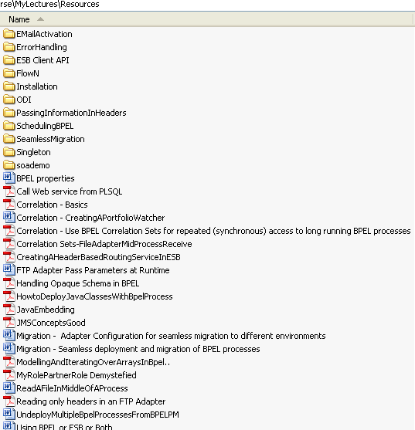
And more…..

Slide 41
Recap
What are we learning in this course - Oracle SOA
Oracle SOA
Enterprise Service Bus
BPEL
Software Details
Demo
Course Objectives
Some differentiators

Slide 42
About the Instructor
6+ yrs exp. in Fusion Middleware and Oracle Applications
3 yrs in Oracle Purchasing development for Release 12 and Fusion at Oracle Corporation, India
Taught Network Security at IBM, Bangalore as lecturer from BITS Pilani
Gold Medalist from BITS Pilani and Delhi College of Engineering Back

Slide 43
Thank you

